Slide 1

Introduction to Quantum Machine Learning for Supervised Learning
Anton Dekusar
Julien Gacon
IBM Quantum / © 2021 IBM Corporation

Slide 2
Table of Contents
Recap of classical machine learning and neural networks
Introduction to quantum machine learning
Qiskit Machine Learning

Slide 3
Machine Learning
Statistics
Behavioral economics
Machine learning
Mathematics
Computer science
Genetics/evolution
Neuroscience
“Learning patterns from data in order to draw inferences”

Slide 4
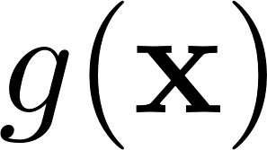
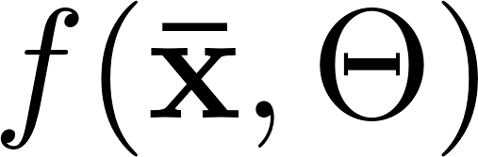
Machine Learning
Function approximation and optimization
Unknown function
approximates
Model
Observable data
Parameters
How do we choose a model?
How do we find optimal parameters?

Slide 5



Machine Learning Ingredients: Data
Pictures
Videos
Spreadsheets
Numerical/Categorical
. . .

Slide 6
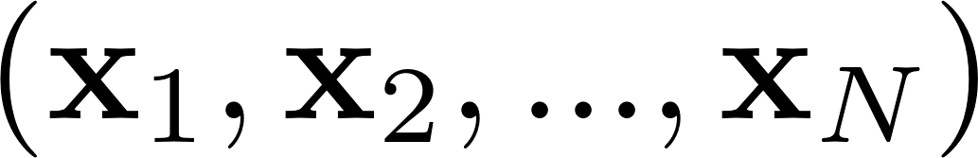
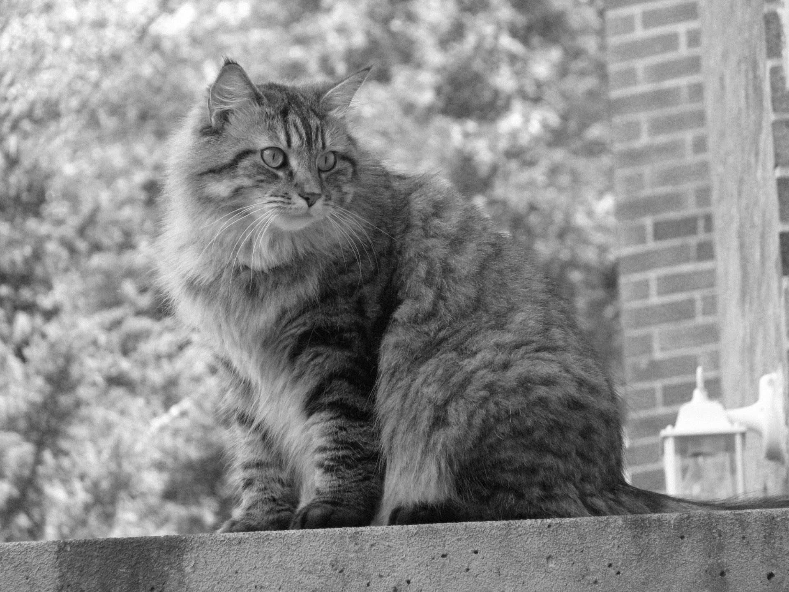


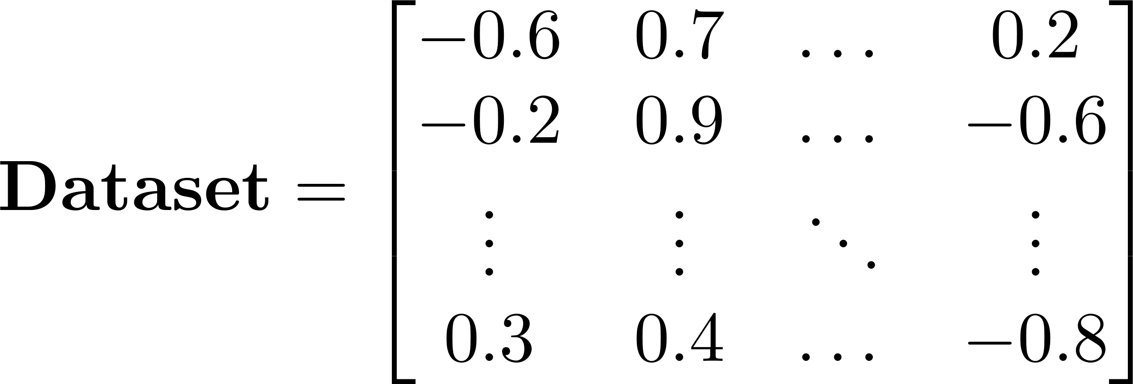






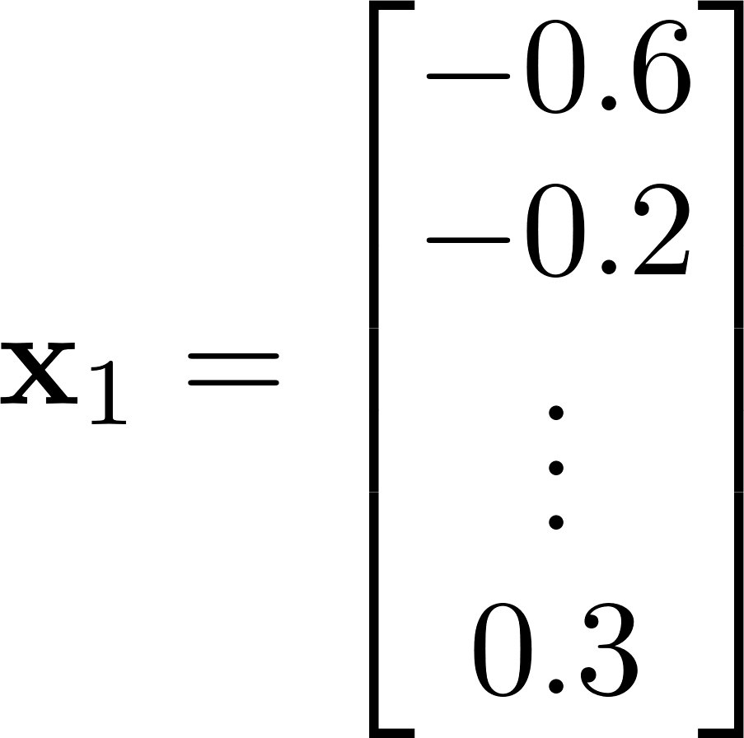
Machine Learning Ingredients: Data
Let’s consider a black and white image pixel by pixel
A dataset consists of many images:
Every image is a sample, samples in total
All images can be represented as a huge matrix:
pixels
pixels
Every pixel has value in , from dark to light
Every image can be represented as a vector of elements:
elements or features

Slide 7

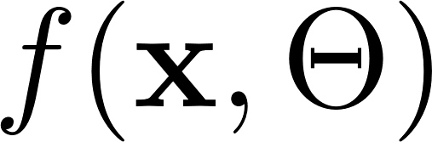

Machine Learning Ingredients: Model
A model is a function that takes data, depends on some parameters and maps this data to some prediction
Model
Data
Model parameters
Prediction:
Number
Label
Distribution

Slide 8

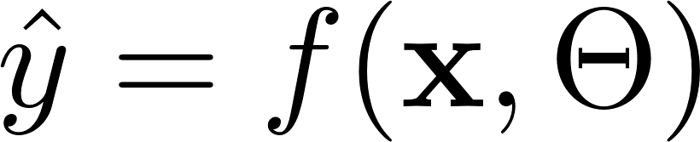

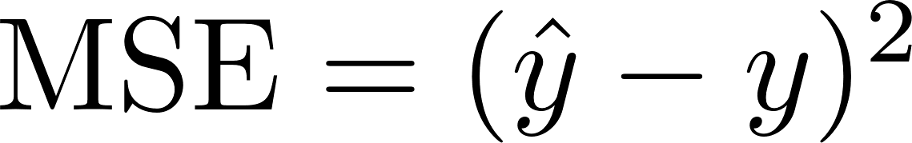
Machine Learning Ingredients: Cost
A cost function takes our model predictions and true value and score them in such a way you know how good your model is performing:
Where obtained from our model and
is ground truth
Usually, we want to minimize the value of the cost function
For instance, a cost function may be a mean squared error:

Slide 9



Machine Learning Examples
Classification
SPAM!
Machine learning model
NOT SPAM
Task: use emails seen so far to produce rules to predict whether future emails are spam or not

Slide 10

Machine Learning Examples
MNIST Dataset
Classification
Learn patterns from data and classify new data

Slide 11
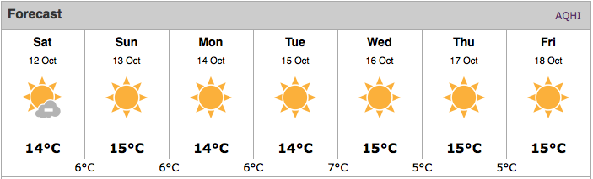
Machine Learning Examples
Regression
Predicting values based on relevant information

Slide 12
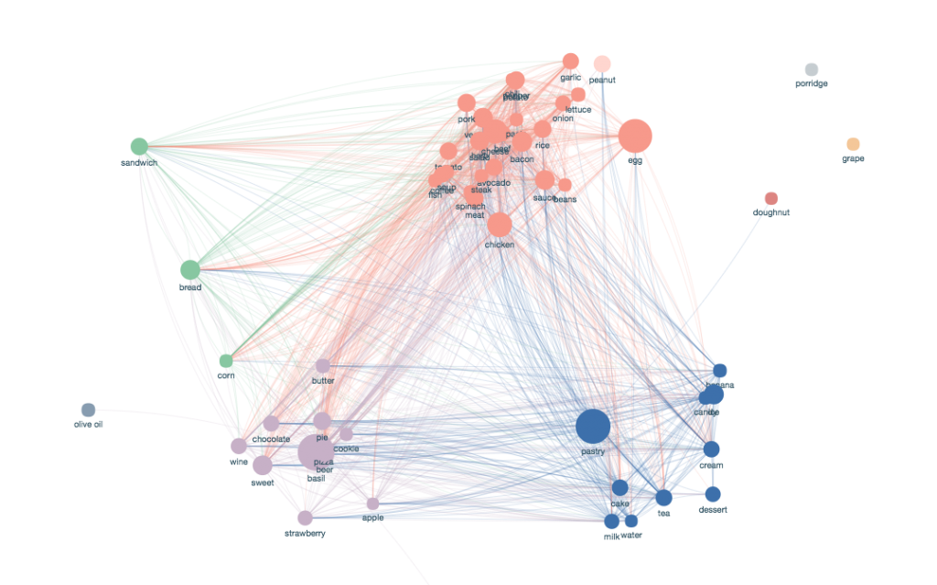
Machine Learning Examples
Clustering
Identify consumers with similar behavior

Slide 13
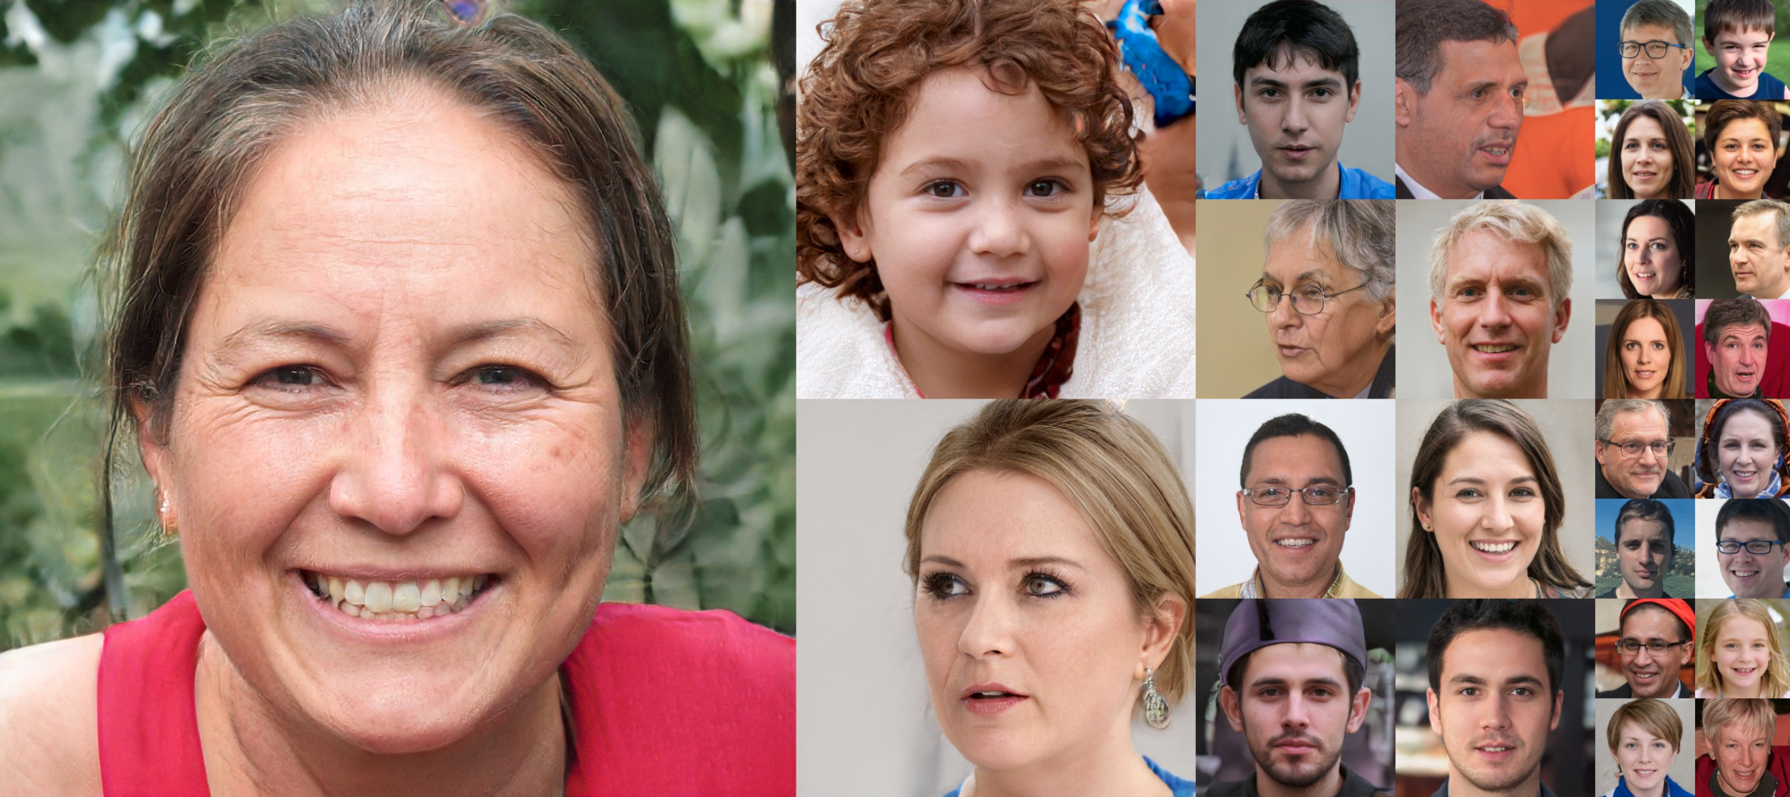
Machine Learning Examples
Generate data
Learn patterns or structure from data and reproduce them

Slide 14
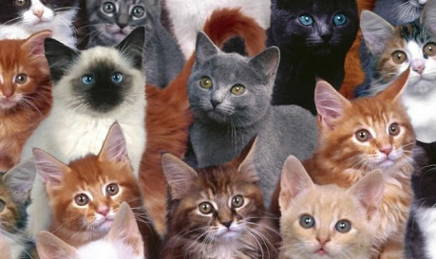
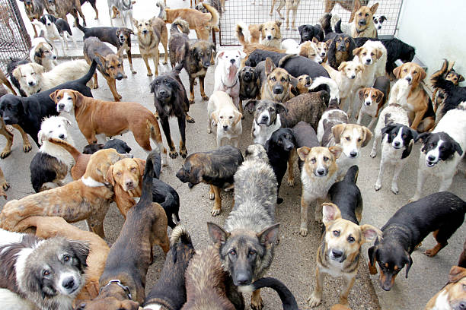
Supervised Learning
Function approximation and optimization
Supervised setting
VS

Slide 15
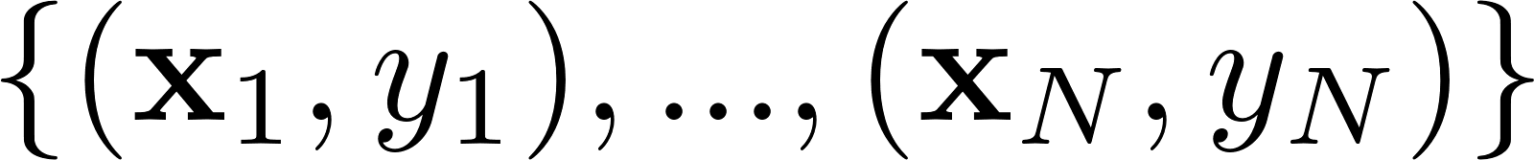
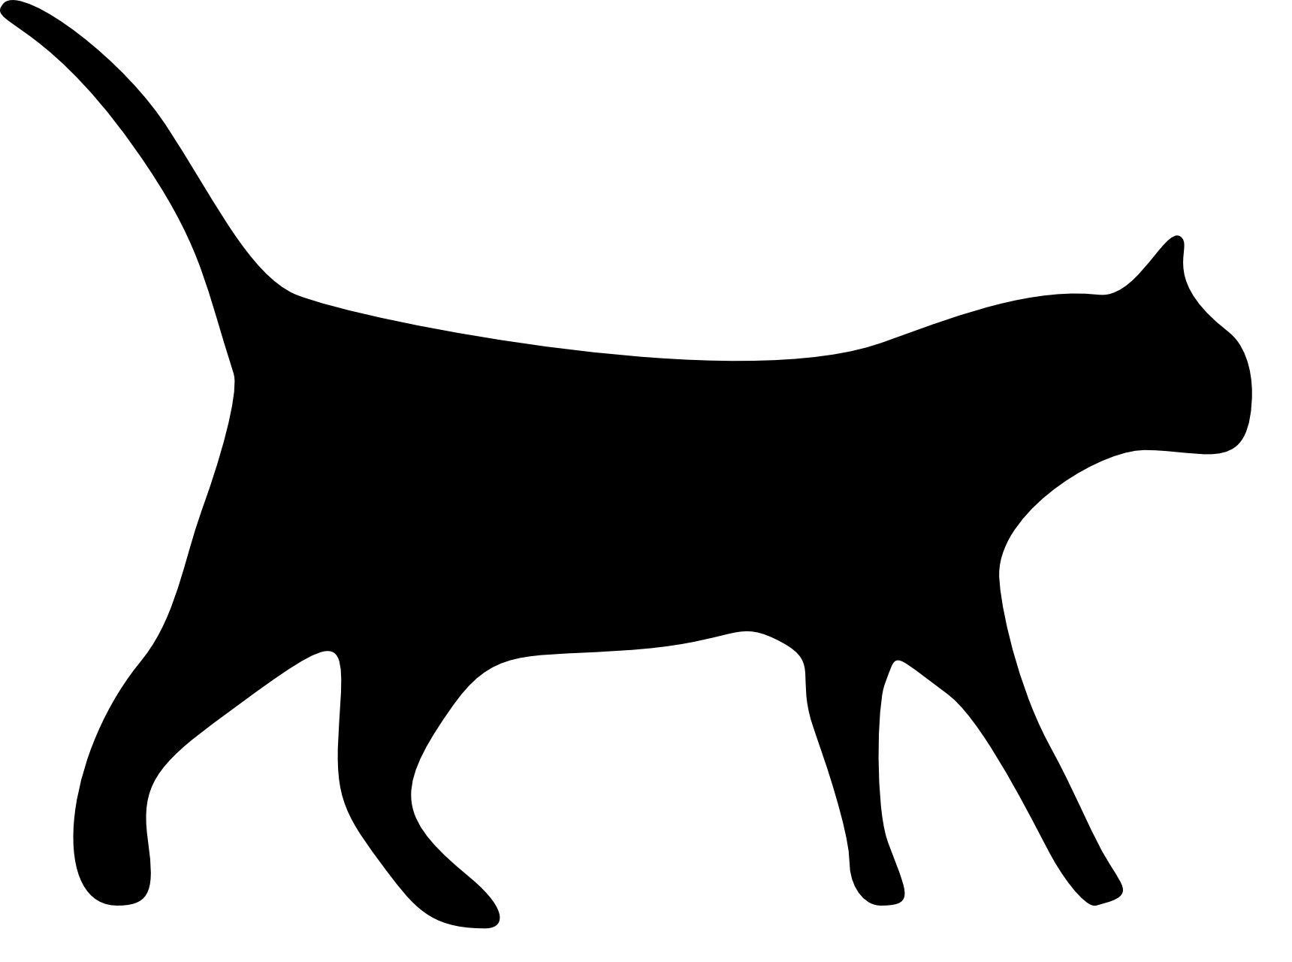

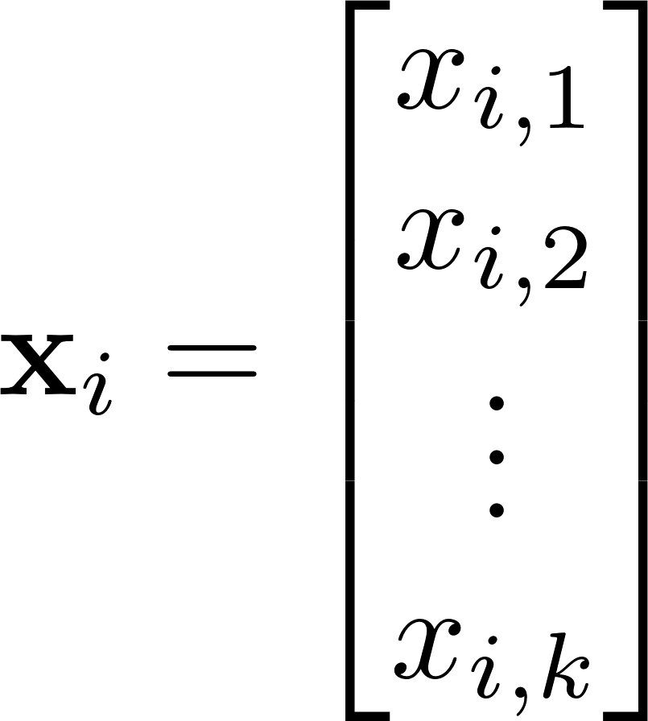
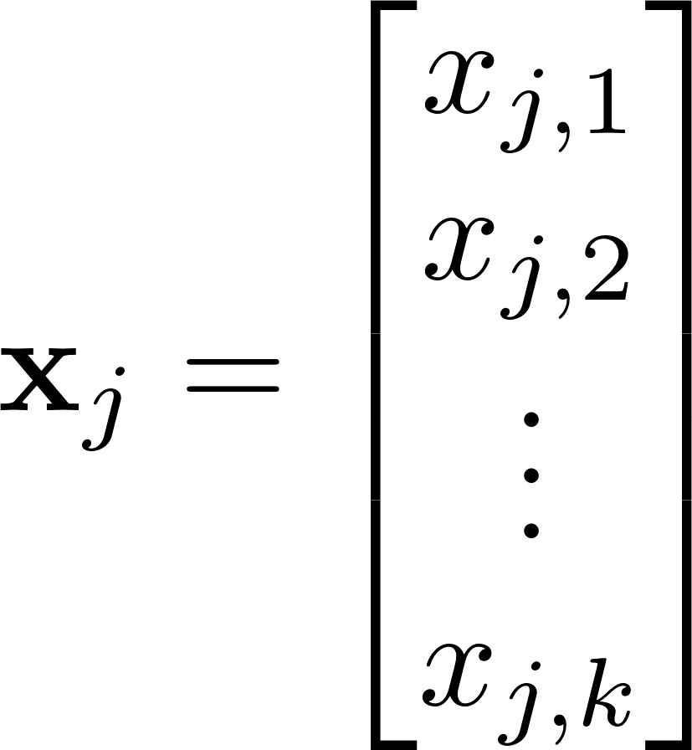
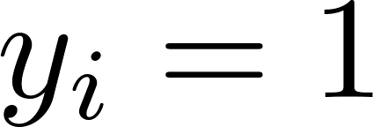
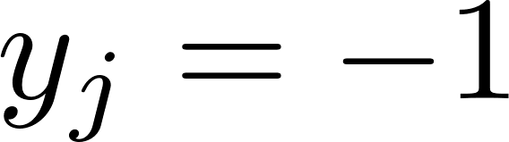


Supervised Setting: Data
Classify whether it is a cat or dog using certain features of animals
Dataset
Split the dataset into the training and test datasets
Labels
Features
80% Training dataset of the size samples
20% Test dataset of the size samples
There are features in the dataset, e.g. weight, tail length, etc

Slide 16
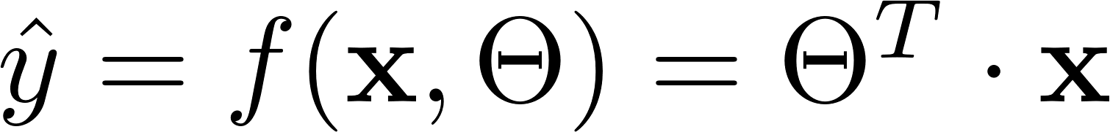
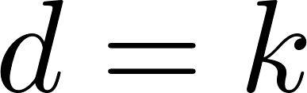
Supervised Setting: Model
Classify whether it is a cat or dog using certain features of animals
Linear model
Dimensionality of the vectors , where is the number features
We can estimate , a predicted label, by feeding a sample from the dataset and compare the predicted value versus ground truth value from the dataset.

Slide 17
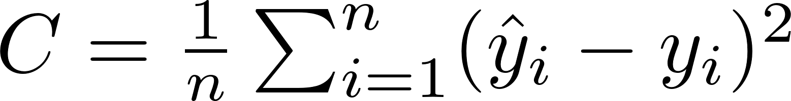
Supervised Setting: Cost
Classify whether it is a cat or dog using certain features of animals
For the samples in the training dataset we may compute cost as
And we want to minimize the cost function to have a good model

Slide 18

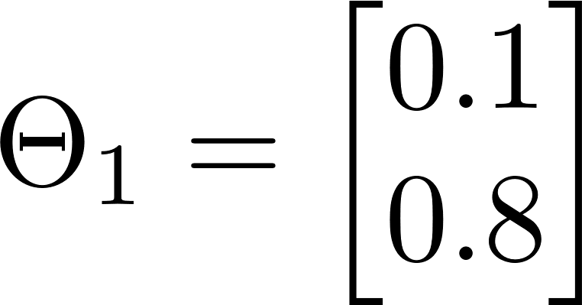
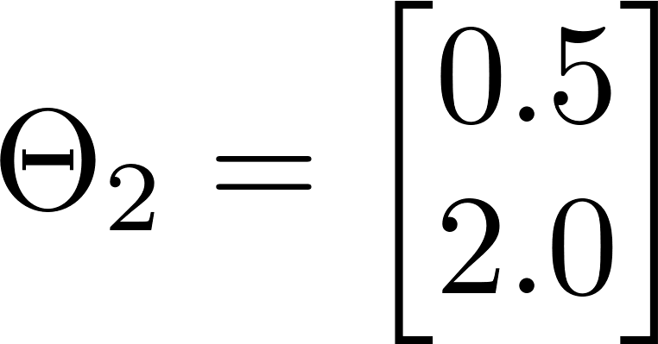
How do we optimize our model
COST
Global minimum, we want to find it!

Slide 19
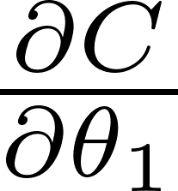
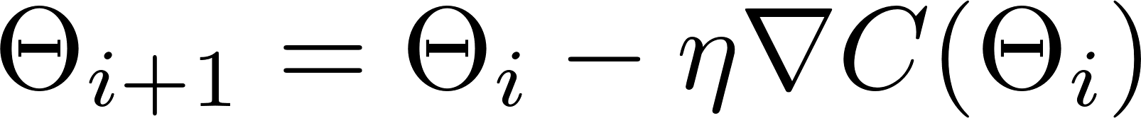





How do we optimize our model
COST
Gradient descent algorithm:
where is the learning rate

Slide 20
How do we optimize our model
COST
Gradient descent algorithm:
where is the learning rate
Local minimum

Slide 21
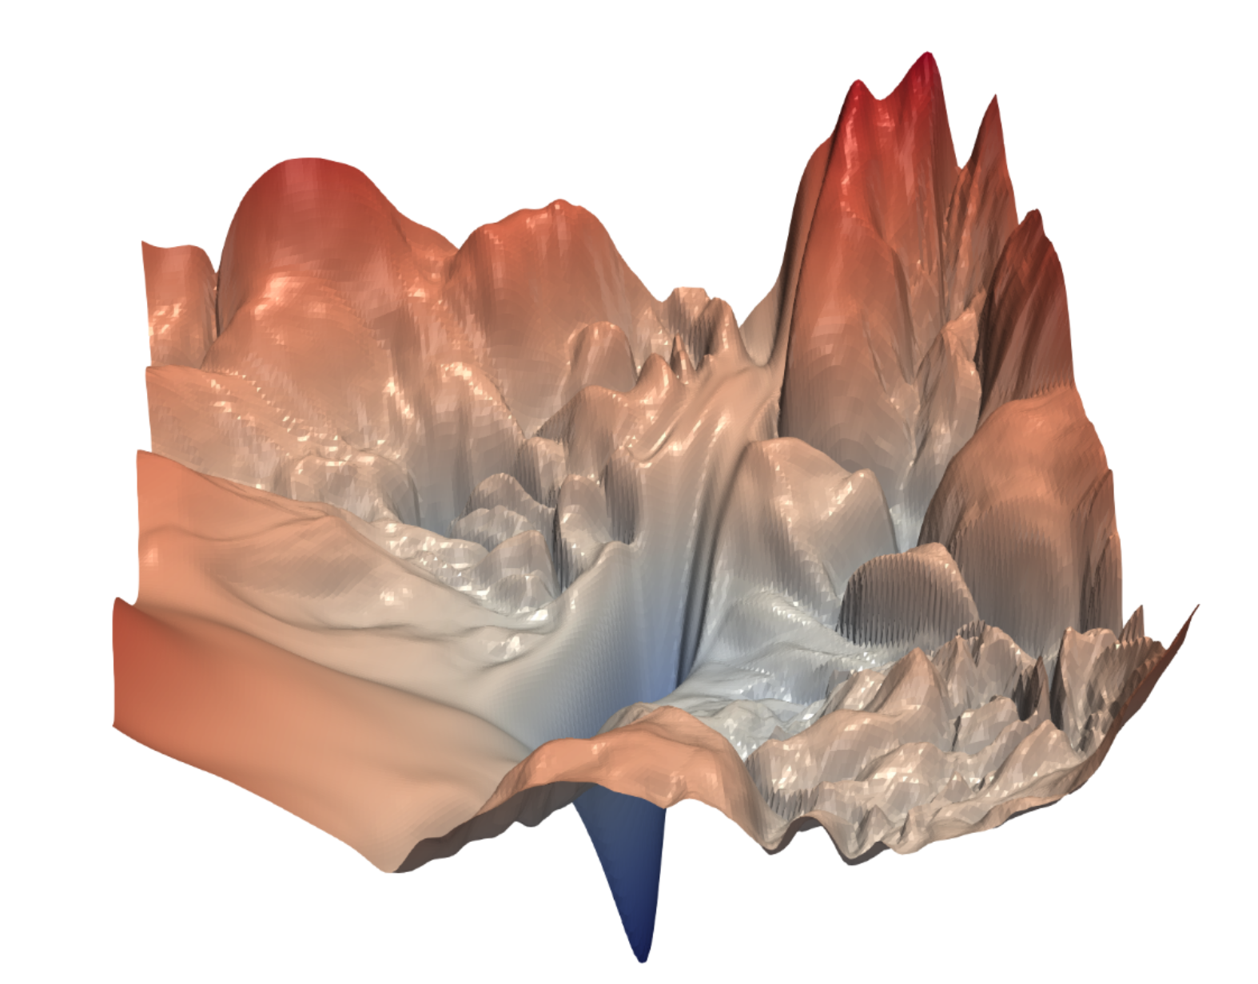
How do we optimize our model
Cost function landscapes can be very complicated!
Stochastic gradient-descent methods work well to avoid local minima in practice
Image source: Li, H., Xu, Z., Taylor, G., Studer, C., & Goldstein, T. (2017). Visualizing the loss landscape of neural nets. arXiv preprint arXiv:1712.09913.

Slide 22

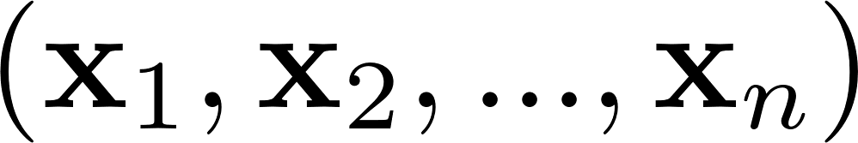
Training the model
Training data:
Feed in the samples:

Slide 23
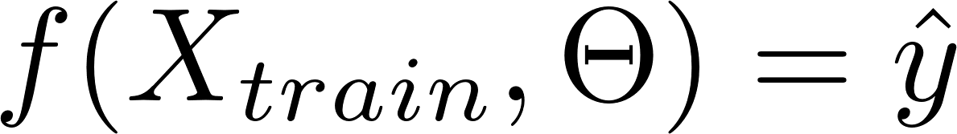
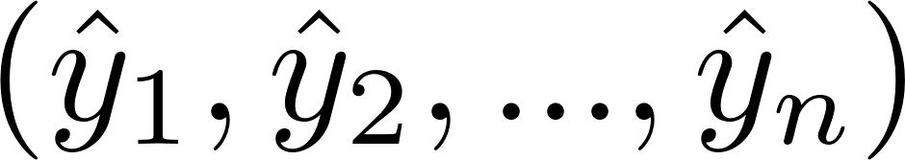
Training the model
Training data:
Model:
Pick a random
Compute predicted labels

Slide 24


Training the model
Training data:
Model:
Cost:
Compute cost for the predicted labels and ground truth

Slide 25
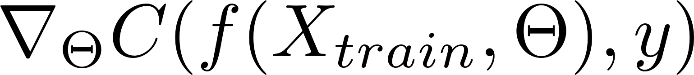
Training the model
Training data:
Model:
Cost:
Gradient:
Compute gradient of the cost function for the samples of the dataset

Slide 26
Training the model
Training data:
Model:
Cost:
Update:
Gradient:
Update parameters and move to the next iteration in the optimization process

Slide 27
How do we assess our model?

Slide 28

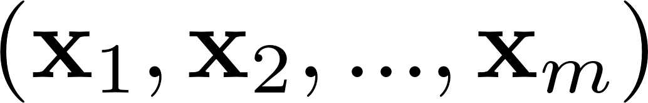
How do we assess our model?
Training data:
Feed in the test samples:

Slide 29
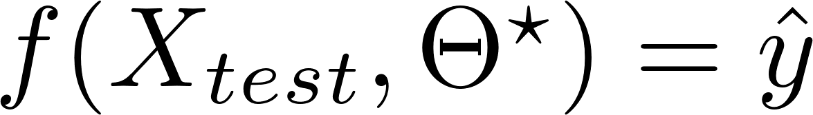

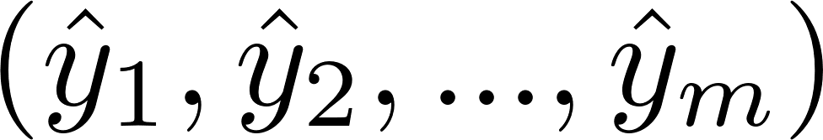
How do we assess our model?
Training data:
Model:
Use parameter values obtained in the optimization
Compute predicted labels

Slide 30

How do we assess our model?
Training data:
Model:
Cost:
Evaluate the cost and assess whether it is good or not

Slide 31
Choosing the right model
Generalization: how well will our model perform on unseen data?
Training dataset
Test dataset

Slide 32
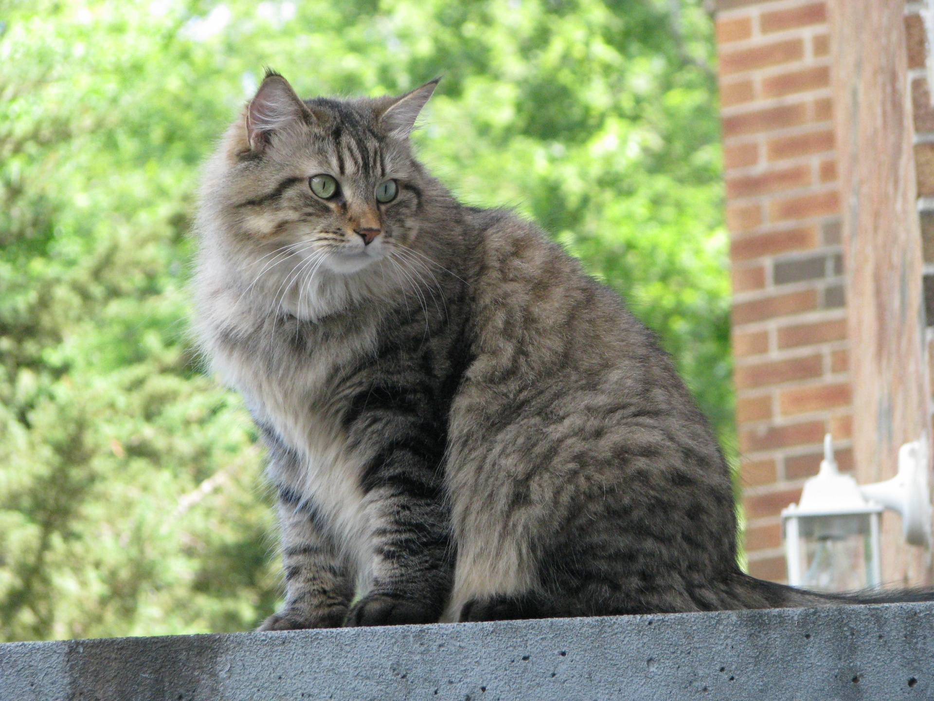
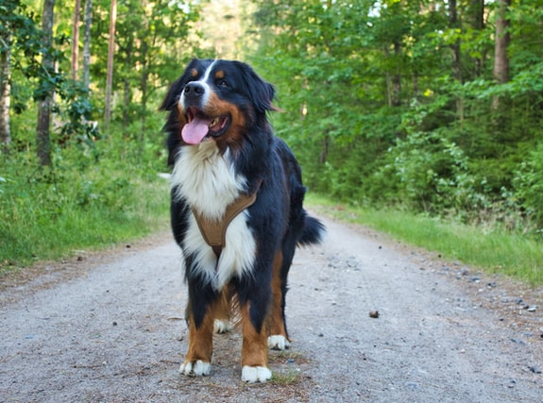
Choosing the right model
Generalization: how well will our model perform…
VS

Slide 33
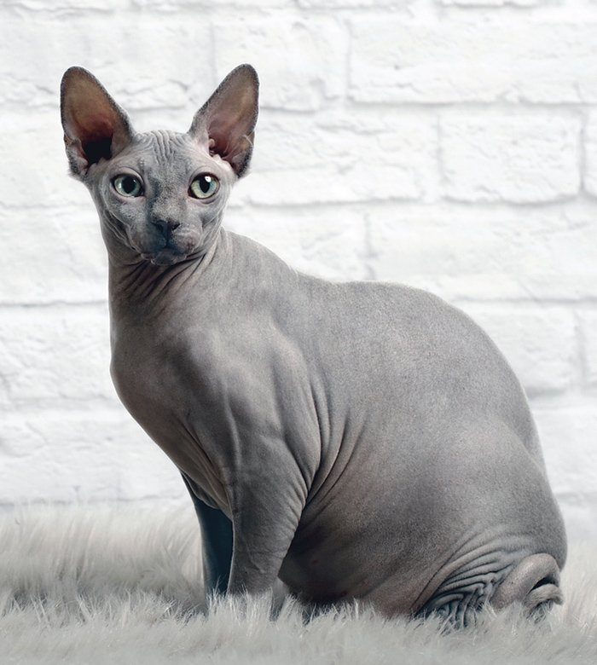
Choosing the right model
Generalization: how well will our model perform…
VS
… on unseen data?

Slide 34
Choosing the right model
Variance
Capacity

Slide 35
Models with high variance
The model captures a very specific pattern observed only in the training data and misclassify the test data
Training dataset
Test dataset

Slide 36
Choosing the right model
Variance
Bias
Capacity
Simple models
Complicated models

Slide 37
Models with high bias
The model does not capture enough patterns from data to produce correct results
biased model
good model
Training dataset
Test dataset

Slide 38
Choosing the right model
Generalization error
Underfitting
Overfitting
Variance
Bias
Optimal capacity
Capacity

Slide 39
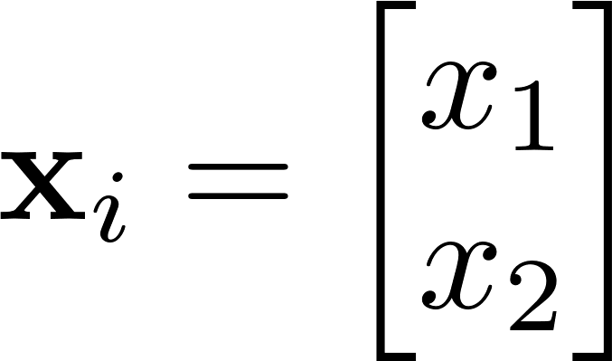
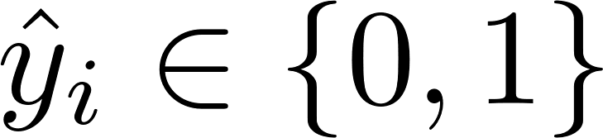
A quick recap of neural networks
Problem setup
Two-dimensional data, we want to classify our data

Slide 40
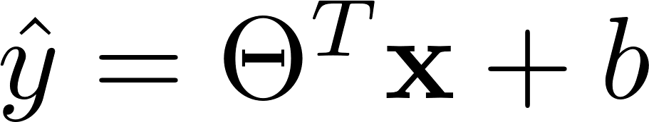
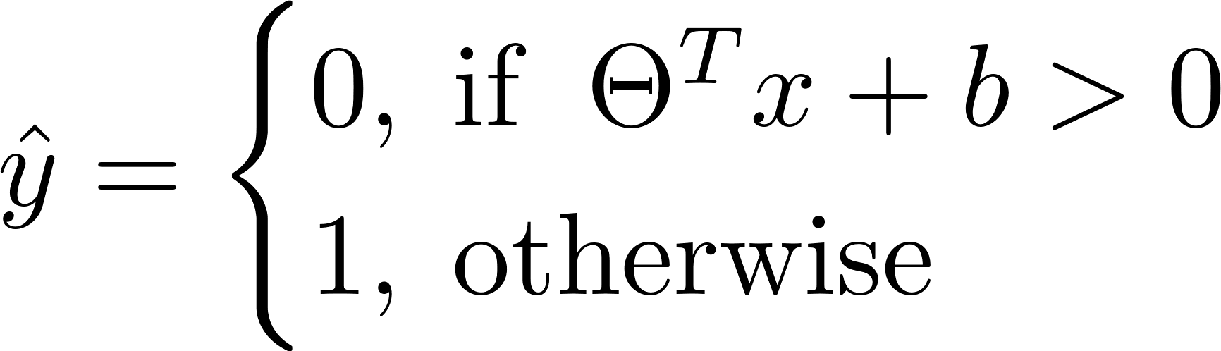
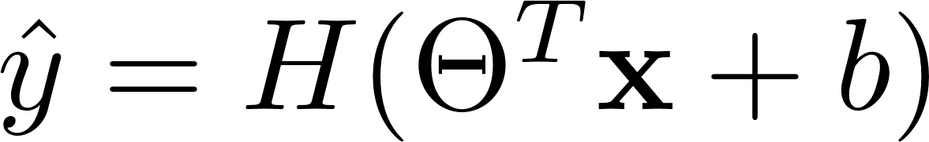

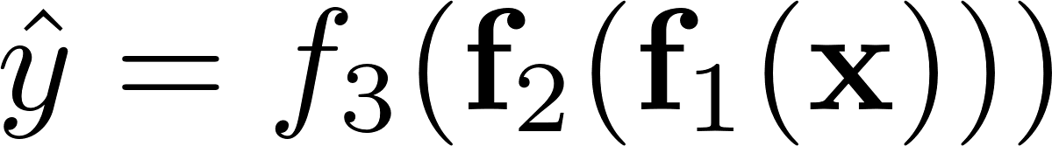
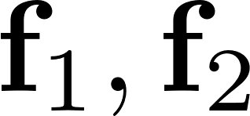
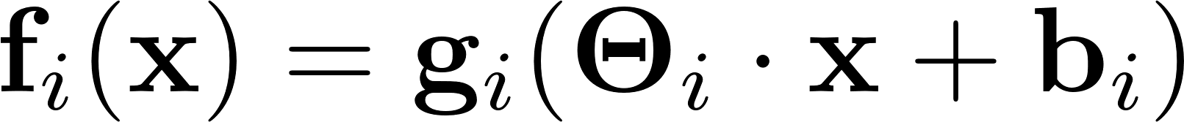


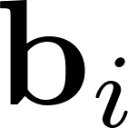

Neural Networks
How to build a neural network:
Linear model
Perceptron
or , where is an activation function, in our case the Heaviside step function
Multilayer perceptron or feed-forward neural network, as an example here we have 3 layers
Where are now vector functions, defined as
And is an activation function, is a matrix of weights or parameters, is a bias or intercept vector of the -th layer of the network.

Slide 41


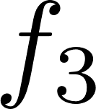
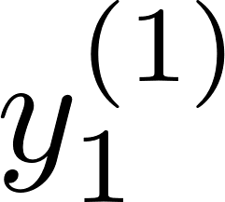
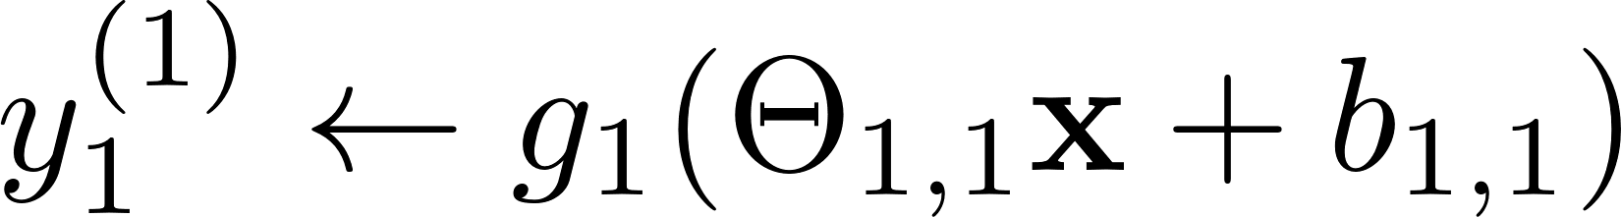













Neural Networks
Layer 1,
Layer 2,
Layer 2,
The hundred-page machine learning book

Slide 42

Neural Networks
Backpropagation and the chain rule

Slide 43
Table of Contents
Recap of classical machine learning
Introduction to quantum machine learning
Qiskit Machine Learning

Slide 44
Quantum machine learning
Data processing
CC
CQ
our focus
Representation of data
QC
QQ

Slide 45
Quantum machine learning
Data processing
quantum
CC
CQ
training data
model
loss function
Representation of data
QC
QQ
update
gradients

Slide 46










How can we build a quantum model?
data encoding
measurement
data
model
output
$$|0⟩$$
$$z_{1}$$
$$|0⟩$$
$$z_{2}$$
$$|0⟩$$
$$ℇ(x)$$
$$U(θ)$$
$$z_{3}$$
.
.
.
$$⋮$$
$$|0⟩$$
$$z_{n}$$
Havlicek et al. Nature 567 7747

Slide 47
How can we build a quantum model?
data encoding
measurement
data
model
output
$$|0⟩$$
$$z_{1}$$
$$|0⟩$$
$$z_{2}$$
$$|0⟩$$
$$ℇ(x)$$
$$U(θ)$$
$$z_{3}$$
.
.
.
$$⋮$$
$$|0⟩$$
$$z_{n}$$
Feature map
Havlicek et al. Nature 567 7747

Slide 48
Data encoding
Havlicek et al. Nature 567 7747

Slide 49



Data Encoding: Basis Encoding
Idea
Encode binary data in basis states
Example
Represent 2 qubits to represent 2 bits
binary
Pro Easy to load
Con N qubits for N bits

Slide 50

Data Encoding: Amplitude Encoding
Idea Encode normalized data in state amplitudes
Pro Need log₂(N) qubits for N classical bits
normalize
load
Con Loading is difficult!
Example

Slide 51





Data Encoding: Angle Encoding
Idea Encode data in rotation angles
$$|0⟩$$
$$|0⟩$$
N qubits for N dimensions
.
.
.
Higher-order encoding Repeat rotations + include entanglement, e.g. in the ZZ feature map
x₁
Schuld et al. Phys. Rev. A, 103, 3 (2021)

Slide 52
How can we build a quantum model?
data encoding
measurement
data
model
output
$$|0⟩$$
$$z_{1}$$
$$|0⟩$$
$$z_{2}$$
$$|0⟩$$
$$ℇ(x)$$
$$U(θ)$$
$$z_{3}$$
.
.
.
$$⋮$$
$$|0⟩$$
$$z_{n}$$
Ansatz
Havlicek et al. Nature 567 7747

Slide 53

Ansatz
Complete Hilbert space
Hardware efficient ansatz
repeated
Ansatz A
Ansatz B
solution
Problem specific ansatz
Use problem knowledge to choose an ansatz!
Ex: Does the wave function only have real amplitudes?
Sim et al. arXiv:1905.1087 (2019)

Slide 54
How can we build a quantum model?
data encoding
measurement
data
model
output
$$|0⟩$$
$$z_{1}$$
$$|0⟩$$
$$z_{2}$$
$$|0⟩$$
$$ℇ(x)$$
$$U(θ)$$
$$z_{3}$$
.
.
.
$$⋮$$
$$|0⟩$$
$$z_{n}$$
Havlicek et al. Nature 567 7747

Slide 55
Measurement
Measurement
classical state
z
collapse
,
quantum state
,
Repeat 1000 times:
y
counts
728
x
272
0
1
state
Expectation value

Slide 56










Post Processing
Sampling-based
measure bitstrings
label
0 with Pr(011)
1 with Pr(010)
$$|0⟩$$
$$z_{1}$$
mapping
e.g. parity: even or odd number of 1s?
$$|0⟩$$
$$z_{2}$$
label
010
011
$$|0⟩$$
$$ℇ(x)$$
$$U(θ)$$
$$z_{3}$$
Expectation-based
.
.
.
$$⋮$$
measure expectation value
label
1 with Pr = (1 + 0.5) / 2
mapping
$$|0⟩$$
$$z_{n}$$
e.g. sign

Slide 57

Quantum model
data encoding
measurement
data
model
output
(1) Encode classical data into a quantum state
(2) Apply a parametrized unitary
$$|0⟩$$
$$z_{1}$$
$$|0⟩$$
$$z_{2}$$
(3) Perform measurement to extract classical data (z₁, … , z_{n})
$$|0⟩$$
$$ℇ(x)$$
$$U(θ)$$
$$z_{3}$$
(4) Do classical post-processing to get prediction y=g(z)
.
.
.
$$⋮$$
(5) Use optimization techniques (like gradient descent) to optimize $θ$
$$|0⟩$$
$$z_{n}$$

Slide 58
Optimization
training data
model
loss function
update
gradients
how can we compute the gradients?

Slide 59
Optimization
Example Binary classification using cross-entropy loss
parameters we optimize
probability for label 1
true label, 0 or 1
Gradient calculation
We need to evaluate this on a quantum computer!

Slide 60

















Calculating gradients
For sample- and expectation-based labels we need to evaluate
,
Parameter-shift rule
Finite difference
$$R_{Y}(θ_{1})$$
$$R_{Y}(θ_{5})$$
$$R_{Y}(θ_{1})$$
$$R_{Y}(θ_{5})$$
$$R_{Y}(θ_{2})$$
$$R_{Y}(θ_{6})$$
$$R_{Y}(θ_{2})$$
$$R_{Y}(θ_{6})$$
$$−$$
$$R_{Y}(θ_{3})$$
$$R_{Y}(θ_{7})$$
$$R_{Y}(θ_{3})$$
$$R_{Y}(θ_{7})$$
SPSA
$$R_{Y}(θ_{4}+s)$$
$$R_{Y}(θ_{8})$$
$$R_{Y}(θ_{4}−s)$$
$$R_{Y}(θ_{8})$$
Linear combination of unitaries
Schuld et al. arXiv:1811.11184 (2018)

Slide 61


Optimization: Qiskit Gradient Framework
Gradients (and Hessians) of
Quantum Fisher Information
Natural gradients

Slide 62
Quantum Kernel

Slide 63





Problem Setting
Class -1
Supervised binary classification of
Given: train set
test set
class map
Goal: find a class map
that agrees well with the unknown map determining all true labels
Class +1

Slide 64





Support Vector Machine (SVM)
Class -1
Linear decision function
Only works for linearly separable data!
Maximize the margin (convex optimization)
Class +1

Slide 65



Kernelized SVM
Introduce a nonlinear feature transformation
Hilbert space
linear in new feature space?
Kernel trick Rewrite the SVM problem to only explicitly depend on
not the large feature vectors

Slide 66




Kernelized SVM: Example
Original data
Feature map
Kernel
feature space
original space

Slide 67

Quantum SVM
Idea Access exponentially large Hilbert space of qubits!
evaluate
feature map
67

Slide 68

Quantum SVM
feature map
Quantum feature map Defined by a quantum circuit
…
…

Slide 69
Quantum SVM
feature map
Quantum feature map Defined by a quantum circuit
Quantum kernel (Hilbert-Schmidt inner product)
…
…

Slide 70

Quantum SVM
kernel evaluation
feature map
measurement
Quantum feature map Defined by a quantum circuit
Quantum kernel (Hilbert-Schmidt inner product)
…
…
…

Slide 71

Quantum SVM
kernel evaluation
feature map
measurement
Quantum Advantage? Proven for a (very artificial) dataset + kernel: exponential speedup over classical ML models
… but still an open question for more general data!
…
…
…
feature map
Liu et al. Nat. Phys. 17, 1013–1017 (2021)

Slide 72
Table of Contents
Recap of classical machine learning
Introduction to quantum machine learning
Qiskit Machine Learning

Slide 73
Qiskit Machine Learning
Connectors
TorchConnector
Regressors
NeuralNetworkRegressor
VQR
QSVR
NeuralNetwork
Feature Map
Ansatz
Kernel
Classifiers
NeuralNetworkClassifier
VQC
QSVC
NeuralNetwork
Feature Map
Ansatz
Kernel
Computational
Units
Neural Networks
Kernels
OpflowQNN
TwoLayerQNN
CircuitQNN
QuantumKernel
Operator
Feature Map
Ansatz
Quantum Circuit
Feature Map
Qiskit
(circuits, operators, gradients, optimizers)

Slide 74
Qiskit Machine Learning Package
qiskit_machine_learning
Root package
algorithms
Core package for algorithm, base classes, trainable models are here
classifiers
Classifiers: NeuralNetworkClassifier, QSVC, VQC
distribution_learners
Implementation of qGANs
regressors
Regressors: NeuralNetworkRegressor, QSVR, VQR
circuit.library
Only one feature map: RawFeatureVector, the rest are in Qiskit Terra
connectors
Implementation of the PyTorch connector
datasets
Utility functions for loading QML tailored and predefined datasets
kernels
Implementation of QuantumKernel
neural_networks
A package for quantum NNs: CircuitQNN, OpflowQNN, TwoLayerQNN and base classes
runtime
A future package for the TorchRuntimeClient, under development
utils
Utility package, loss function implementation is here

Slide 75
Quantum Neural Networks
CircuitQNN
Directly takes the quantum circuit’s measurements as output without an observable.
The output can be used either as a batch of samples, i.e., a list of bitstrings measured from the circuit’s qubits, or as a sparse vector of the resulting sampling probabilities for each bitstring.
The former is of interest in learning distributions resulting from a given quantum circuit, while the latter finds application, e.g., in regression or classification.
A post-processing step can be used to interpret a given bitstring in a particular context, e.g. translating it into a set of classes.
OpflowQNN
Allows users to combine parametrized quantum circuits with quantum mechanical observables. The circuits can be constructed using, for example, building blocks from Qiskit’s circuit library, and the QNN’s output is given by the expected value of the observable.
TwoLayerQNN is a special case of the OpflowQNN that takes as input a feature map and an ansatz.

Slide 76
Neural Network Classifier/Regressor
NeuralNetworkClassifier
A base class that can used to fit a model
Takes a QNN as input and then use it for classification
NeuralNetworkRegressor
A base class that can used to fit a model
Takes a QNN as input and then use it for regression

Slide 77
VQC/VQR
These are two convenience implementations – the Variational Quantum Classifier (VQC) and Variational Quantum Regressor (VQR).
Extend NeuralNetworkClassifier and NeuralNetworkRegressor correspondingly.
Both take a feature map and an ansatz and construct the underlying QNN automatically.

Slide 78
QuantumKernel, QSVC/QSVR
QuantumKernel
A class that can be used to directly compute kernel matrices for given datasets using quantum computers
QSVC/QSVR
A lightweight wrapper around scikit-learn SVC/SVR implementation
Make use of already existing SVM implementation from scikit-learn

Slide 79
Pytorch Connector
TorchConnector takes any QNN and makes it available as a PyTorch Module.
QNNs provide both passes: forward and backward, users can integrate QNNs into a PyTorch workflow including the backpropagation to compute gradients.
Training of such hybrid model should be done by using PyTorch techniques.
QNNs can be a part of a bigger complex computation, such as a deep neural network that consists of classical as well as quantum layers.

Slide 80


Following the tutorials live
Log into the Quantum Experience at quantum-computing.ibm.com (and create an account if you haven’t yet!)
Start the Quantum Lab
Navigate to qiskit-tutorials/qiskit-machine-learning

